Slide 1

Car: price prediction
26th July,2022
Internship-27
Presented by:
Someshwar Dipak

Slide 2
Acknowledgement
Data Science with ML
SME – Sapna Verma
Flip Robo Technology

Slide 3
Why Car Price Prediction Need:
With the covid 19 impact in the market, we have seen lot of changes in the car market.
Now some cars are in demand hence making them costly and some are not in demand hence cheaper.
One of our clients works with small traders, who sell used cars.
With the change in market due to covid 19 impact, our client is facing problems with their previous car price valuation machine learning models.
So, they are looking for new machine learning models from new data. We have to make car price valuation model.

Slide 4
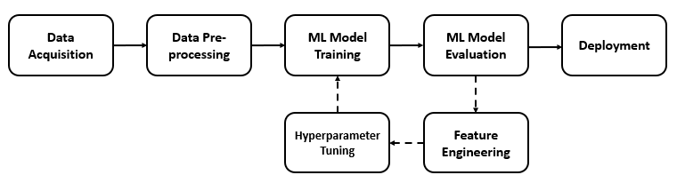
Car: PRICE PREDICTION Diagram:

Slide 5
Visualization of Car Price

Slide 6
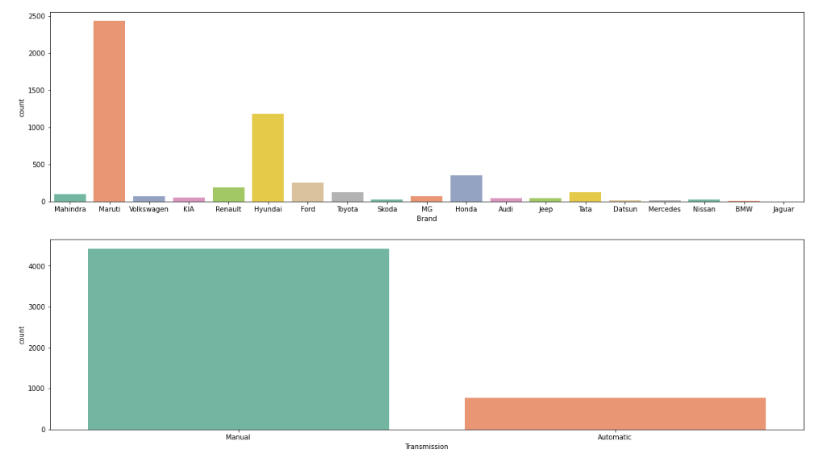
Graphs:
This countplot gives numbers of counts and showing that which brand is more selling then other brand In this Maruti and Hyundai selling is because of price is low than other brands.
In second graph transmission of manual car count is higher than automatic because price of manual car is low then automatic car.

Slide 7
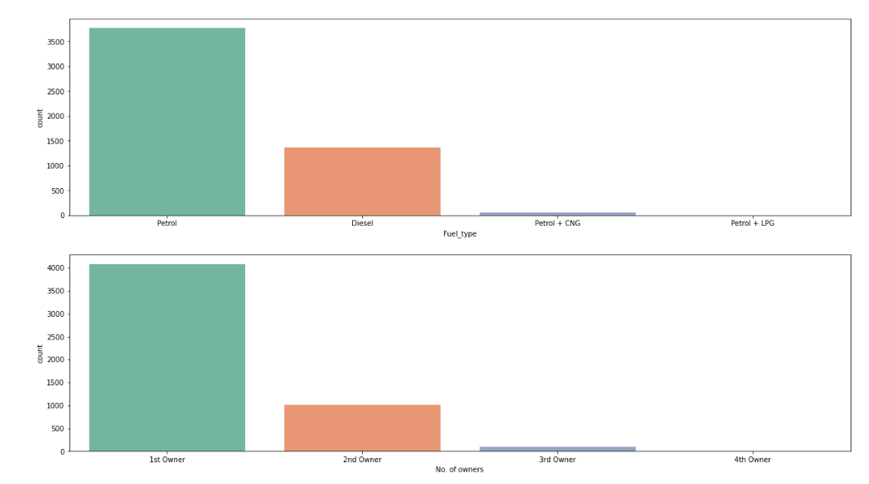
Graphs:
In first graph selling of petrol car is higher then others because of price of petrol car is lower then other fuel type cars.
In second graph shows that when car is used then client is first check condition and owners of cars. In this 1st owner car price is high then others.

Slide 8
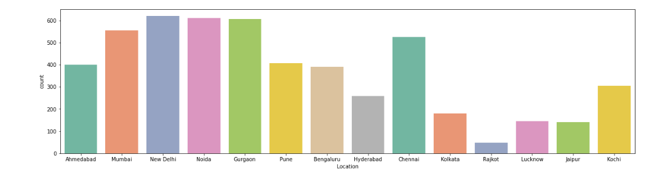
Graphs:
In this graph selling of used car is high in metro cities like Delhi, Mumbai, Chennai, Noida etc. The price of high in this cities because of they are metro cities compare to other cities.

Slide 9
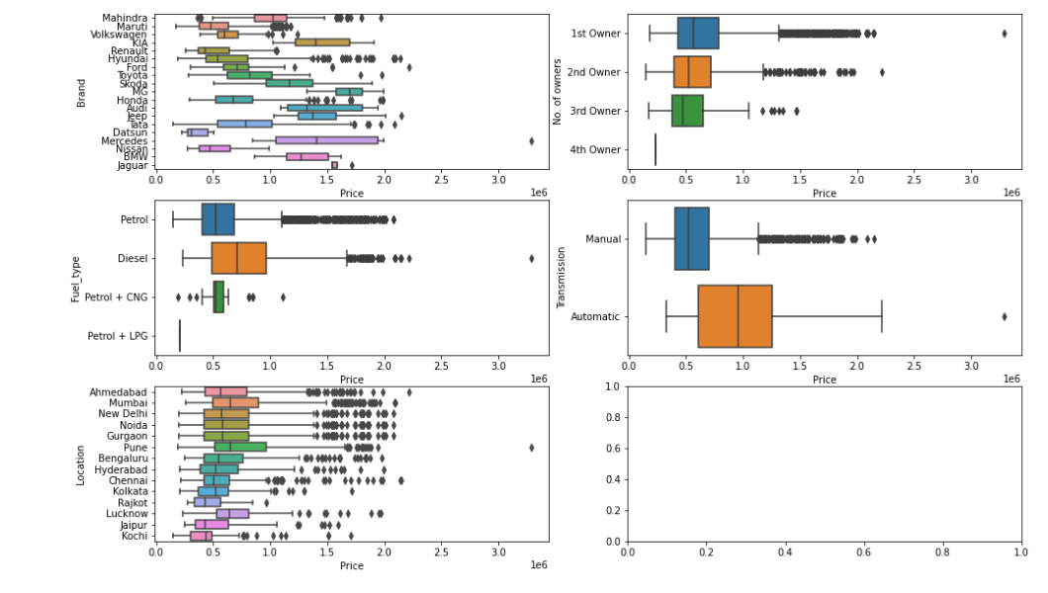
Graphs:

Slide 10
Graphs Desc:
In previous graphs compare price(dependent) column with other(independent) columns.
In first graph price column compare with brand. The luxurious car price has been higher then others. The normal brands car price has normal price.
In second graph price column compare with no. of owners column. In used car the price of 1st owner car is higher then others. 2nd owner car price is lower then 1st owner and so on. The 3+ owner car price is very low.
In third graph the price of diesel car is higher then other fuel types cars.
In fourth graph the price of automatic cars is higher then manual cars.
In fifth graph the price of cars is different with different-different locations. The price of cars is high in Pune, Ahmedabad, Chennai then other cities.

Slide 11
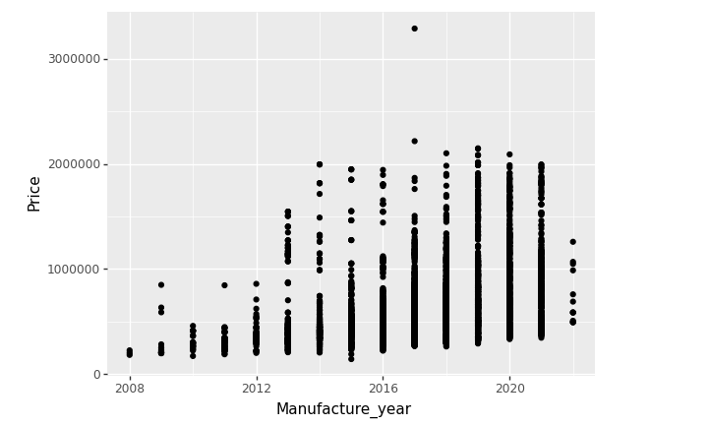
Graphs:

Slide 12
Graphs Desc:
In previous graph show the price of cars with different-different years.
In 2017 the car price is very higher then other years.
In 2020 and after years the car price is low because of impact of covid-19 the price of car has been price due to covid-19 situation.

Slide 13
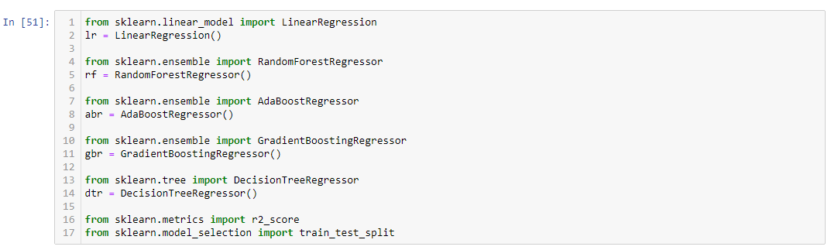
Model Building, Model Evaluation and Selecting the best model

Slide 14
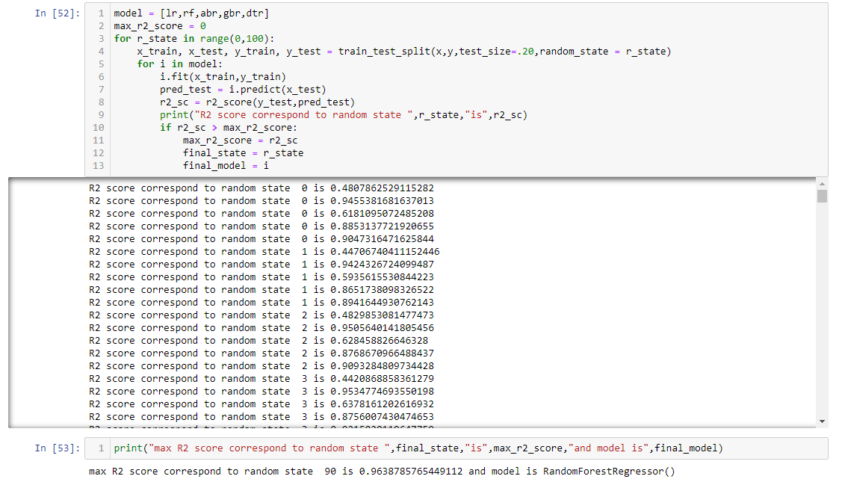
Model Building, Model Evaluation and Selecting the best model

Slide 15
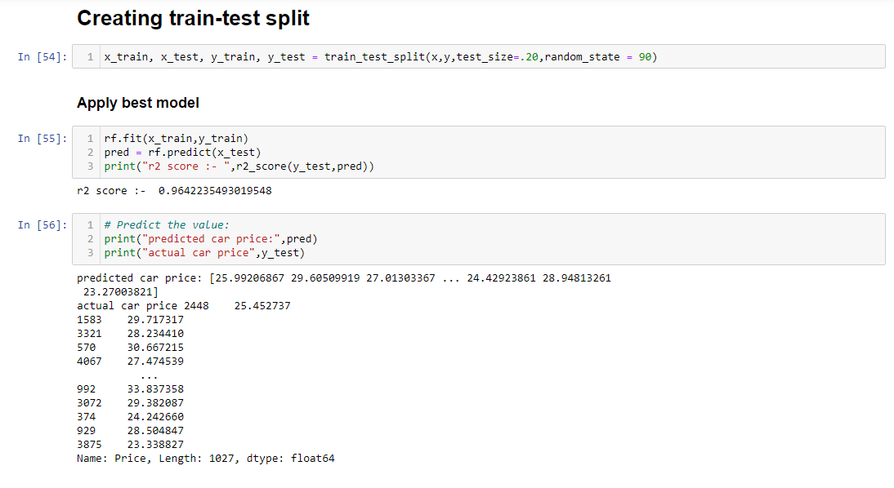
Model Building, Model Evaluation and Selecting the best model

Slide 16
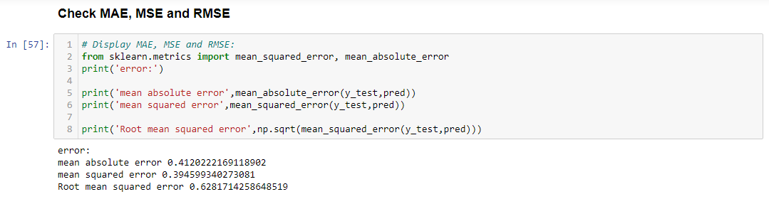
Check mae, mse and rmse:

Slide 17
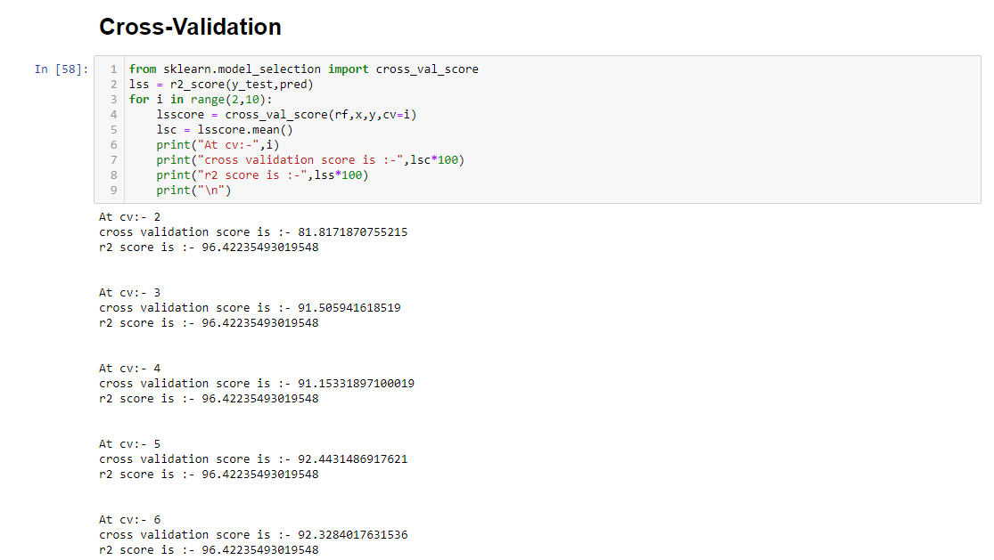
Cross-Validation:

Slide 18
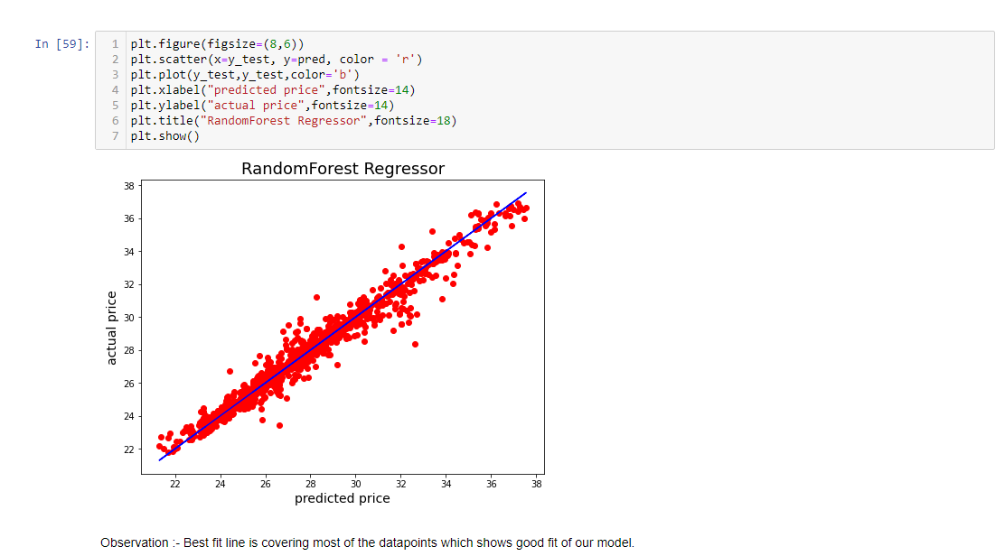
Actual price vs Predicted price:

Slide 19
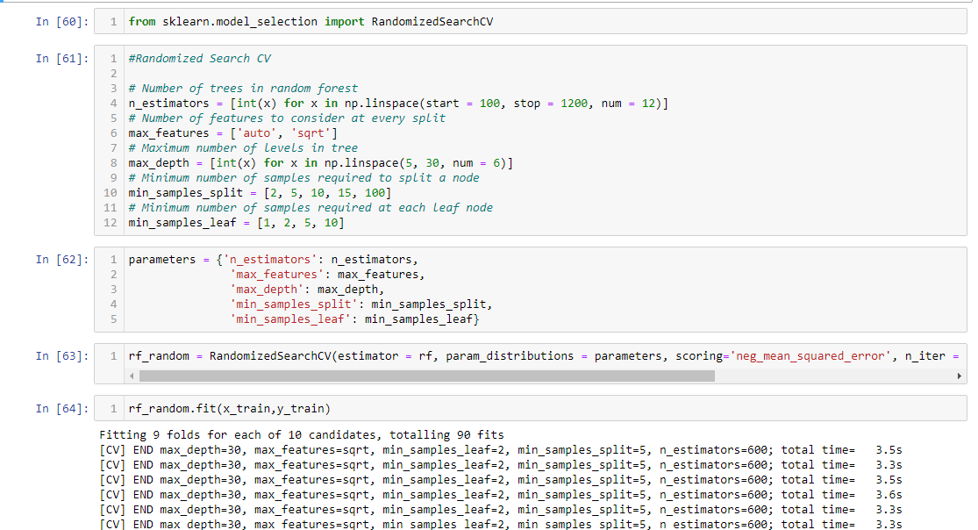
Hypertuning of the model:

Slide 20
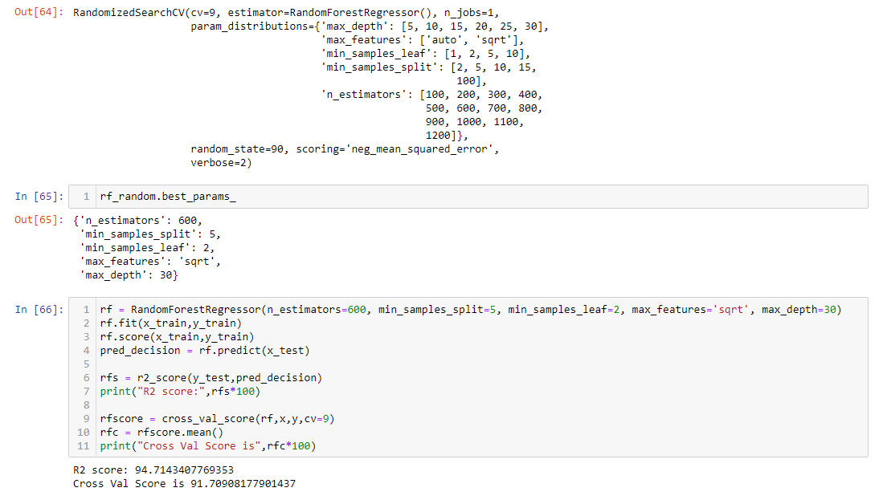
Hypertuning of the model:

Slide 21
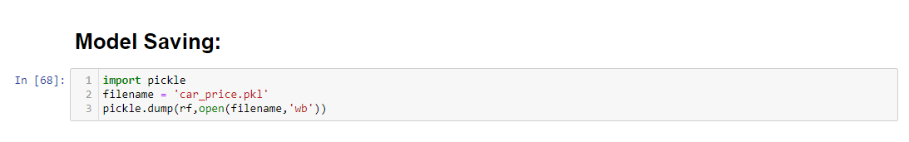
Model Saving:

Slide 22
Conclusion:
This Kernel investigates different models for car price prediction.
Different types of Machine Learning methods including LinearRegression, RandomForestRegressor, AdaBoostRegressor, GradientBoostingRegressor and DecisionTreeRegressor in machine learning are compared and analysed for optimal solutions.
Even though all of those methods achieved desirable results, different models have their own pros and cons.
The RandomForestRegressor is probably the best one and has been selected for this problem.
Finally, the RandomForestRegressor is the best choice when parameterization is the top priority.

